Slide 1
Summary
– Data Analysis:
In this update we cover the decision criteria we are using, the user data required, and establish a framework for how recommendations are selected.
After threshold checking, preliminary results are sent to users to monitor their space and map out the quality of space around them (for public campuses)
The recommendation engine uses effect sizes from peer reviewed literature and industry standards to estimate the benefit of strategies, and suggest one that fits its user.
It also allows users to experiment with their own strategies

Slide 2
Previous Week’s Deliverables assignments
Criteria to research - healthy limits based on health conditions - metrics for assessing indoor air quality - think of recommendations - effect of different actions and actuation on PM, CO2 and Temp Hardware to build - test bed - CO2 sensor, - Wooden box - AutoCAD or pdf to svg, with ports scaled for the air input - Potential weatherstripping for outdoor use - easily bought weatherstripping -

Slide 3






The Road So Far
VOC, PM, CO2, temperature, and user data is sent to cloud
VOC
PM
User performance requirements
CO₂
Motivation
Mapping
Implementation
Review

Slide 4
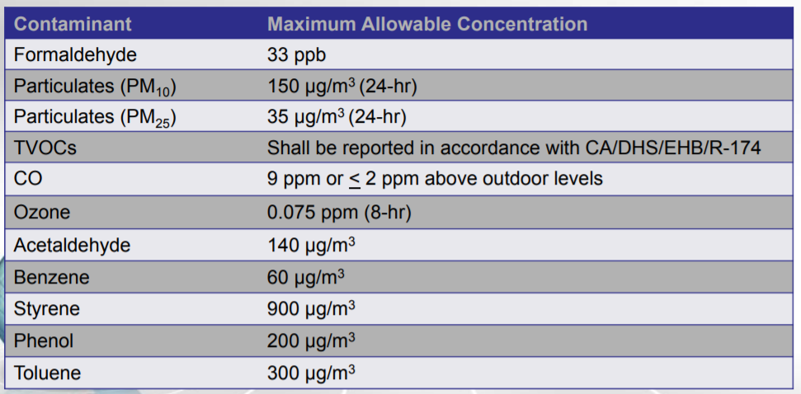
Aggregation and Threshold Checking
Processing of data for display and and decision making
Standard and performance based criteria
Aggregation of data
Statistical summary
Recommendation engine
Cumulative exposure, real time plotting
IAQ heat map
Motivation
Mapping
Implementation
Review

Slide 5
Recommendation Engine
Compare target IAQ change to to potential actions and advise.
Building facts (use input)
Function for expected effect size.
Select optimal strategies.
Potential Strategies
Turn on fans
Modify HVAC schedule
Change finishes
Cross ventilation
Air filtration
Avoid pollutant generating activities
…. or allow users to test how effective their own strategies are
Outdoor air quality (from other sensors)
Recommendation displayed on web app
Motivation
Mapping
Implementation
Review

